Slide 1
Postdoctoral Benefits Program
Plan Year 2025
Presented by: Gallagher Benefit Services

Slide 2


Agenda
Who is Gallagher Benefit Services?
Review of all Benefits, Rates and Plan Designs
Explanation of the Online Enrollment Process
Gallagher Contact Information
2

Slide 3

Who is Gallagher Benefit Services?
We design, implement, administer, and provide customer service, to postdoc benefit programs nationwide, offering our services to campuses and labs across the country.
At GBS, our Account Managers understand the unique requirements of Postdocs relating to benefits:
Assistance when there are language challenges for foreign nationals
Support through the complicated world of the United States healthcare system
Assistance with choosing a benefit plan to meet the needs of your family
Education with learning how to access an appropriate provider to avoid unnecessary costs
It is our goal to make the enrollment process easy for you, and make your access to the program’s benefits as simple & uncomplicated as possible.
3

Slide 4
What’s New for 2025?
Effective January 1, 2025, departments/PIs/grants will be responsible to pay 100% of the monthly insurance premiums for postdocs and their dependents.

Slide 5
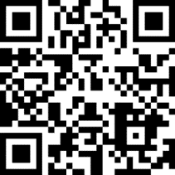
What’s New for 2025?
We have a new tool that will assist you in learning about your benefits! Our new virtual benefits platform with Brite (https://britehr.app/CaseWestern) allows you to access your health insurance information in an easy to read format.
For our non-native English speakers, the Brite platform allows you to review the benefits information in your own language (just adjust the language setting on your computer)!

Slide 6
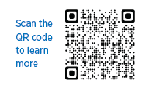
What’s New for 2025?
Gallagher Marketplace
Check out additional types of insurance to protect you and your family!
      Home/Renter’s insurance
      Auto Insurance
      Pet Insurance
      Legal Protection
      Discount Programs
This is a voluntary program and any fees would be your responsibility.

Slide 7





“Bundled” Benefits Offered Through
The Postdoctoral Benefit Program
Plan Type | Insurance Type | Company
HNO | Medical
OAMC/POS | Medical
DPPO | Dental
PPO | Vision
Life | Life & AD&D
J-1 | Medical Evacuation & Repatriation
EAP | Employee Assistance Program
7

Slide 8

Medical Insurance
Provided by

Slide 9
You have the choice between two medical plans
Aetna Health Network Only (HNO) plan:
You can go to any “in network” doctor or facility
No required primary care physician (PCP)
DO NOT NEED a referral to see a specialist.
The out-of-pocket costs (the most money you would pay out of your own pocket for any services you receive in the plan year) is significantly less on the HNO plan than it is on the Aetna POS Plan.
It is a regional plan with a smaller network.
All the doctors and facilities are in Ohio.
You also can only go to physicians/facilities that are “in network.” Out of network care is not covered.
Aetna Point of Service/ Open Access Managed Choice Plan (POS/OAMC):
More flexibility: See ANY doctor, whether “in network” or “out of network.”
No required primary care physician (PCP)
DO NOT NEED a referral to see a specialist.
Larger, national network; if you are living/working outside of Ohio, this is the plan you must have.
It could cost you more out of pocket, when compared to the HNO plan. The out-of-pocket maximum is higher, and there are charges for things like inpatient hospitalization and outpatient surgery.
**Note: Emergency care is covered regardless of where you are in the USA or abroad.

Slide 10
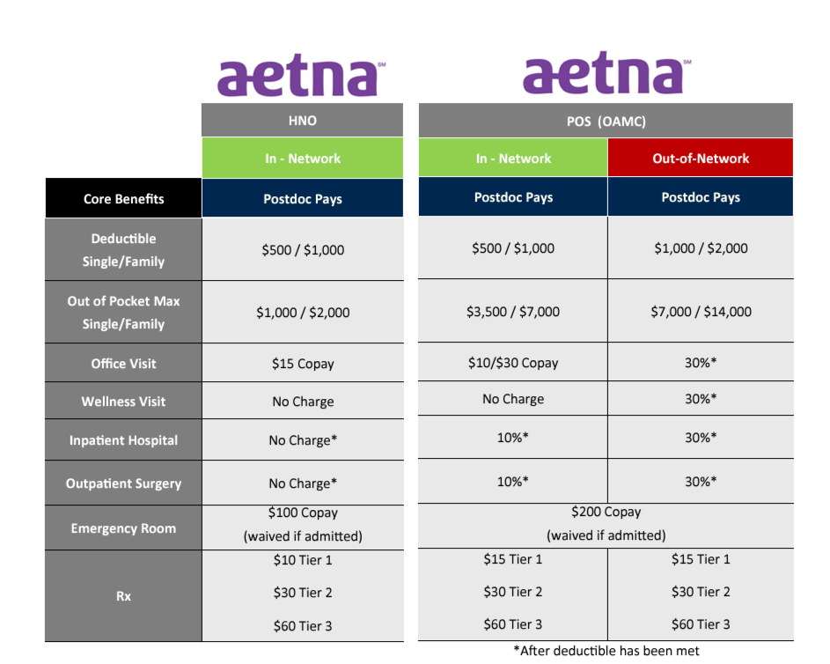

Slide 11
Example: Pregnancy
 | HNO PLAN | POS/OAMC PLAN (IN-NETWORK)
Office Visits | No charge | No charge
Childbirth/Delivery Professional Services | $15 copay/pregnancy, deductible does not apply | 10% coinsurance (you are responsible for 10% of the total bill up to the out-of-pocket maximum) (**Deductible does apply)
Childbirth/Delivery Facility Services | 0% coinsurance (**Deductible does apply) | 10% coinsurance (you are responsible for 10% of the total bill up to the out-of-pocket maximum) (**Deductible does apply)
Example – comparing the two plans
Hypothetical cost to you if the overall cost of childbirth/ delivery is $10,000** | Deductible ($500 for individual/ $1000 for Family) For Childbirth/Delivery Facility Services + $15 Copay for Professional Services = $1,015 estimated charges (family level of coverage) | Deductible ($500 for individual/ $1000 for Family) + 10% coinsurance for Professional Services (estimate $500) + 10% coinsurance for Facility Services (estimate $500) = $2,000 estimated charges (family level of coverage)

Slide 12
Example: Diagnostic Tests
 | HNO PLAN | POS/OAMC PLAN (IN-NETWORK)
Diagnostic Test (X-ray, blood work) | 0% coinsurance for laboratory; $15 copay/visit for x-ray (**deductible does apply) | 10% coinsurance after deductible is met
Imaging Test (CT/ PET Scans, MRIs) | 0% coinsurance (**deductible does apply) | 10% coinsurance after deductible is met
Example – comparing the two plans
Hypothetical cost if you need Bloodwork and the cost is $100** | If you have not yet met your deductible, you would pay the full $100 charge. If you have met your $500 deductible, you would pay $0. | If you have not yet met your deductible, you would pay the full $100 charge. If you have met your $500 deductible, you would pay 10% = $10
Hypothetical cost if you need an X-ray and the cost is $200** | If you have not yet met your deductible, you would pay the full $200 charge. If you have met your $500 deductible, you would pay $15 | If you have not yet met your deductible, you would pay the full $200 charge. If you have met your $500 deductible, you would pay 10% = $20
Hypothetical cost if you need an MRI scan and the cost is $1,000** | If you have not yet met your deductible, you would pay your $500 deductible (only). If you have met your $500 deductible, you would pay $0 | If you have not yet met your deductible, you would pay your $500 deductible + 10% of the balance (10% of $500 = $50) = total of $550. If you have met your $500 deductible, you would pay 10% of $1000 = $100

Slide 13
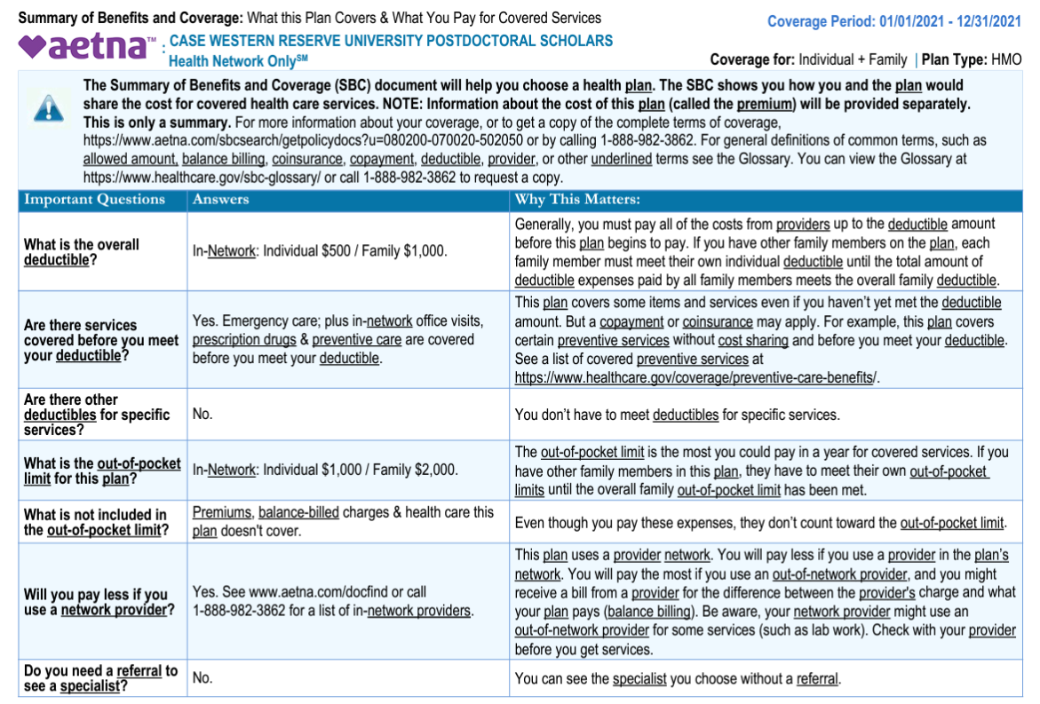
Summaries of Benefits and Coverage
The Patient Protection and Affordable Care Act (PPACA) requires that you be notified that the Summaries of Benefits and Coverage for your medical plans are currently available on our website.
The Summaries of Benefits and Coverage follow the recommended guidelines of PPACA in a standardized format to make them easier to read and comprehend to better serve you in making your plan selections.
You may request a paper copy at no charge by calling the toll-free number on your ID card.
You may also print a copy directly off of the GBS website.

Slide 14
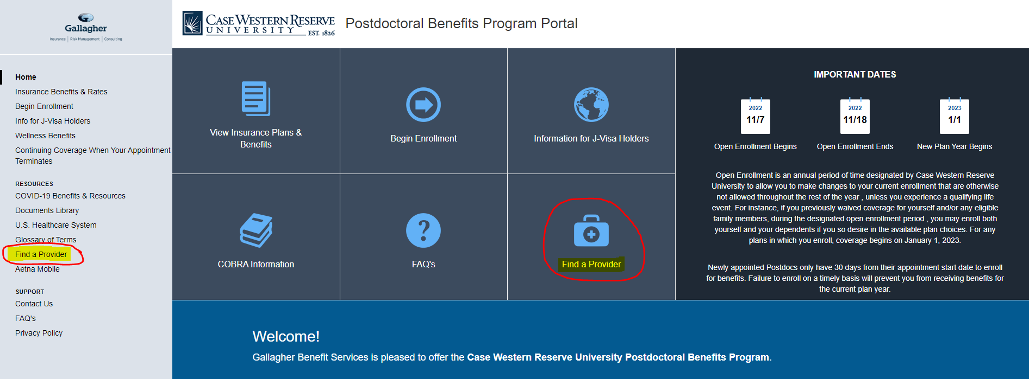
Finding the Nearest Providers
Click the Find a Provider link on the website, choose the appropriate directory, then follow the step-by-step instructions provided in order to locate in-network doctors and facilities near you.

Slide 15

Teladoc Telehealth
With Teladoc, you have access to doctors on your schedule
24/7 access for non-emergency conditions like cold & flue, sinus infections, allergies and more
See U.S. board-certified & state-licensed doctors and pediatricians
Connect by phone, web, or app from anywhere
Costs for primary care medicine telehealth visits are the same as in-person visits
$10 under the OAMC/POS
$15 under the HNO
For more information, visit https://www.teladoc.com/.

Slide 16

Urgent Care Centers
The hospital emergency room is to be used only if the situation is limb or life threatening.
The Urgent Care Center is available to treat most non-life threatening emergencies, as broken bones (not multiple fractures), wounds not bleeding profusely, fevers and flu symptoms. Please note that most urgent cares are not 24 hours, but do have extended evening hours. Some are open on Saturday and Sunday. Please see the in-network Urgent Care Center lists found in the Documents Library.
The Urgent Care Center should be used as often as possible to avoid additional charges.
Aetna Plan | Emergency Room | Urgent Care Center
Health Network Only (HNO) | $100 copay | $35 copay
OAMC/POS Plan | $200 copay | $75 copay

Slide 17
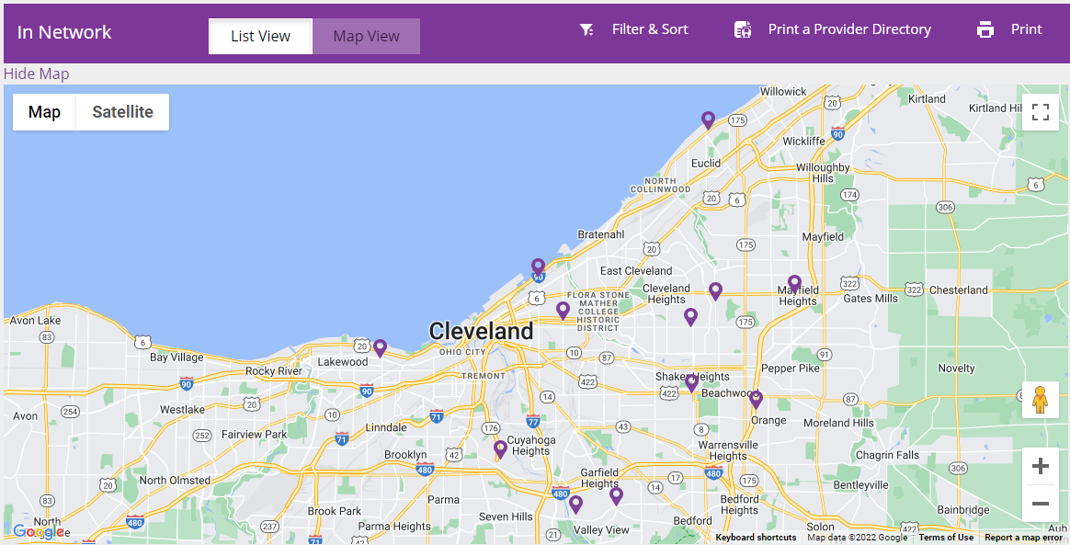
Urgent Care Centers
There are many Urgent Care Centers within 10 miles of
CWRU’s campus. Please see a more comprehensive list on
Postdoc Benefits Portal – Documents Library
Urgent Care Centers closest to Campus serving both
Aetna HNO & OAMC/POS Plans:
Urgent Care Center | Address | Hours
Cleveland Urgent Care LLC | 1956 E. 79th St, CLE 44103 (216) 431-3733 | 8am-8pm Monday – Friday; 9am-5pm Saturday-Sunday
WellNow Urgent Care | 7715 W Ridgewood Dr., Parma 44129 (216) 426-9020 | 7am – 7pm Every Day
DBA Medgroup | 13916 Cedar Road, Univ Hts 44118 (216) 381-9000 | 8am-4pm Mon/Wed/Fri; 8am - 8pm Tues/Thurs; 9am-4pm Saturday
UH Suburban Urgent Care | 1611 South Green Road Suite 63, S. Euclid 44121 (216) 237-5012 | 8am - 5pm Monday-Friday; Closed Saturday/Sunday

Slide 18
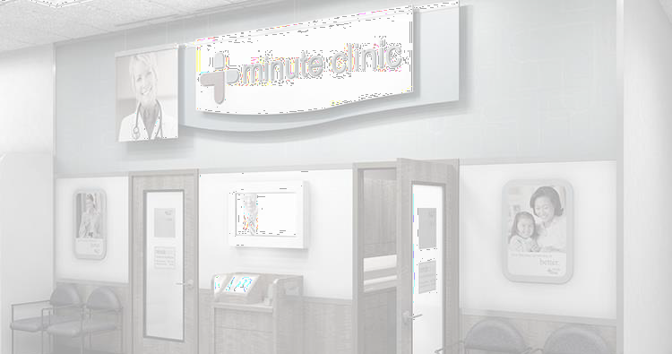
Walk-In Clinics
The Walk-In Clinic is an in-network, free-standing health care facility that is an alternative to a physician’s office for treatment of unscheduled, non-emergency illnesses and injuries and administration of certain immunizations.
It is not an alternative for the emergency room or the outpatient department of a hospital.
It is generally found in a retail location as CVS Pharmacy.
If you use a Walk-In Clinic on the Medical HNO plan, you will pay $15.
If you use a Walk-In Clinic on the Medical OAMC/POS plan, you will pay $10 in-network.

Slide 19
Walk-In Clinics
The lists of “in-network” Walk-In Clinics are different for the two plans offered to CWRU postdocs.
Please see a full list on the CWRU Postdoc Benefits portal – Documents Library
Aetna Health Network Only (HNO)
Walk-In Clinic - HNO | Address
MinuteClinic – In CVS Pharmacy – 4.37 mi | 14440 Cedar Rd, CLE 44121 (866) 389-2727
MinuteClinic – In CVS Pharmacy – 5.68 mi | 1443 Richmond Rd, Lyndhurst 44124 (866) 389-2727
MinuteClinic – In CVS Pharmacy – 7.2 mi | 28100 Chagrin Blvd, Woodmere 44122 (866) 389-2727
MinuteClinic – In CVS Pharmacy – 8.62 mi | 11706 Clifton Blvd, Lakewood 44107 (866) 389-2727
Aetna Open Access Managed Choice/ POS
Walk-In Clinic – OAMC/POS | Address
Cleveland Clinic – 0.86 mi from campus | 9500 Euclid Ave, CLE 44195 (216) 444-2273
Cleveland Clinic – 1.74 mi from campus | 13944 Euclid Ave, CLE 44112 (216) 444-2273
MinuteClinic – In CVS Pharmacy – 4.37 mi from campus | 14440 Cedar Rd, CLE 44121 (866) 389-2727
Cleveland Clinic – 4.47 mi from campus | 315 Euclid Ave, CLE 44114 (216) 444-2273

Slide 20

Prescriptions – Mail Order Pharmacy
You can order maintenance medications through Aetna’s Rx Home Delivery for chronic conditions as asthma, arthritis, diabetes, high cholesterol and heart conditions.
Under the HNO Plan, this service provides you up to a 90-day supply of these medications after a copay of $20 for generic, $60 for brand-name, and $120 for non-formulary brand name drugs.
Under the OAMC/POS plan, this service provides you up to a 90-day supply of these medications after a copay of $30 for generic,
$60 for brand-name, and $120 for non-formulary brand name drugs.
Please click on RX Order Form in the Documents Library on the website for more information, as well as directions on howto order your prescriptions.
For more detailed prescription coverage information go to: clients.garnettpowers.com/pd/case

Slide 21


Wellness Programs
Aetna Navigator - This is an online member portal that allows you to view your medical visits and claims status, print temporary ID cards and gain access to more important information.
Once you have your member ID, you may register for access to this site. There will be instructions on the website to assist you.
Beginning Right – Provides a pregnancy risk survey and a wealth of information to assist you with when either you or your spouse become pregnant.
Fitness Discounts – Aetna offers discounts to a nationwide network of fitness clubs.
Aetna Discount Programs– Discounts for health coaching, at-home weight-loss programs and wellness programs
24-Hour Nurse Line – free access to speak to a registered nurse about health issues – whenever you need to.

Slide 22

Flu & COVID-19 Shot Benefits
Aetna® is a CVS Health® company, which means they recommend CVS Pharmacy® locations for your flu shot.
And it’s safe to get your bivalent COVID-19 booster at the same time. Both vaccines are covered with an Aetna medical plan.
Both the HNO and OAMC/POS plans offer coverage for seasonal flu shots with no copay when you use in-network providers.
For a full list of providers and to make an appointment, you may visit
https://www.aetna.com/individuals-families/medication-safety-vaccines/flu-vaccines.html.

Slide 23


Dental Insurance
Provided by

Slide 24
Postdoctoral Benefit Program
MetLife PPO Dental
Core Benefits | In-Network Postdoc Pays | Out-of-Network Postdoc Pays
Annual Deductible | $0 per individual / $0 per family | $50 per individual / $150 per family
Annual Benefit Maximum | $1,250 per person | $750 per person
Preventive/Diagnostic Care Routine Exams Teeth Cleanings (Prophylaxis) X-rays | 0%* 0%* 0%* | 30%* 30%* 30%*
Basic Procedures Fillings Endodontics Periodontics Oral Surgery Deep Cleaning (Periodontal Maintenance) | 20% 20% 20% 20% 20% | 40% 40% 40% 40% 40%
Major Procedures Crowns Bridgework Dentures | 40% 40% 40% | 60% 60% 60%
Orthodontia (Child Only) | 50% ($1,250 Lifetime Maximum)
26
* Deductible waived for preventive services
For more detailed plan design information go to: clients.garnett- powers.com/pd/case

Slide 25
Accessing the PDP Network
The MetLife Preferred Dentist Program (PDP) plan offers comprehensive coverage.
A Preferred Dentist Program plan incorporates two tiers for delivery of care, and you choose the tier you desire at the time of service:
In-Network (the PDP Tier): This tier offers you the flexibility of seeking service from a PPO dentist. Save out-of-pocket expenses when you receive services from one of more than 80,000 participating dentists who generally agree to charge fees 10 - 35% lower than average
charges in your area.
Out-of-Network Tier: This tier allows you to seek care from any non-network provider. Services are based on a percentage of the
Reasonable and Customary (R&C) charge. If you choose a dentist who does not participate in the network, your out-of-pocket
expenses may be more, since you will be responsible for paying any difference between the dentist’s fee and your plan’s payment for the approved service.

Slide 26
Accessing the Out-of-Network Tier
An example of how seeking out-of-network services can impact your out-of-pocket costs:
Out-of-Network Example: The out-of-network dentist decides to charge $1,000 for a porcelain crown on a molar.
This dentist is not prohibited from charging what they feel can be charged for this service.
Your percentage of cost out-of-network is 40% after the $50 deductible, and Usual, Customary and Reasonable (UCR) is considered $800 for this service: You pay $370
IN ADDITION, you owe the difference between the UCR amount and what the out-of-network dentist decided to charge you ($1,000 - $800), which is an additional $200.
Total estimated cost out-of-network for the porcelain crown on a molar: $570

Slide 27


Vision Insurance
Provided by

Slide 28
Postdoctoral Benefit Program
EyeMed PPO Vision Plan
Core Benefits | In-Network Postdoc Pays | Out-of-Network Postdoc Pays
Eye Exam (every 12 months*) | $10 Copay | Up to $35 allowance
Frames (every 12 months*) | $120 allowance (20% off remaining balance) | Up to $48 allowance
Lenses (every 12 months*) Single Bifocal Trifocal | $25 Copay $25 Copay $25 Copay | Up to $25 allowance Up to $40 allowance Up to $60 allowance
Conventional Contact Lenses** | $135 allowance (additional 15% off balance over allowance) | Up to $95 allowance
Disposable Contact Lenses ** | $135 allowance (no discount on remaining balance) | Up to $95 allowance
Medically Necessary Contact Lenses** | $0 Copay | Up to $200 allowance
*12 months from the date of last service
**M aterials only; in lieu of frames/lenses
For more detailed plan design information go to: clients.garnett-powers.com/pd/case
30

Slide 29


Life & Accidental Death & Dismemberment (AD&D) Insurance
Provided by

Slide 30

Life and Accidental Death & Dismemberment
Insurance
The plan pays $20,000 in the event of a death.
An additional benefit of $20,000 is paid for Accidental Death & Dismemberment if the death is due to an accident.
Postdoctoral Scholars/Fellows holding J-1 Visa status will have the $50,000 medical evacuation and $25,000 of repatriation of mortal remains coverage necessary to fulfill the visa requirements included in the Life and AD&D policy.
In addition, family members holding J-2 Visa status will also be covered for the medical evacuation and repatriation, even if the Postdoctoral Scholar/Fellow waives medical and/or dental coverage.
32

Slide 31


Employee Assistance Program
Provided by

Slide 32


Employee Assistance Program (EAP)
The Employee Assistance Program is a free, confidential benefit to help employees, their household members, dependents in and away from home, and parents and parents-in-law balance work and personal issues.
Services include:
Live, immediate assistance 24 hours a day/ 7 days a week/ 365 days per year
5 FREE Mental Health Counseling Sessions
5 FREE Life Coaching Sessions
Legal assistance (ie: estate planning, wills, real estate, bankruptcy, divorce, custody)
Financial consultation
Personal Assistant (save time with referrals for travel, professional services, cleaning services and more)
Medical Advocacy (get help navigating insurance, obtaining doctor referrals, planning)
And much more!
Whether you would benefit from a one-time consultation or ongoing support, the EAP is available for you 24/7 by calling 1-800-227-6007 or by visiting www.MyImpactSolution.com . You can create an online account using the group code: postdocs.

Slide 33
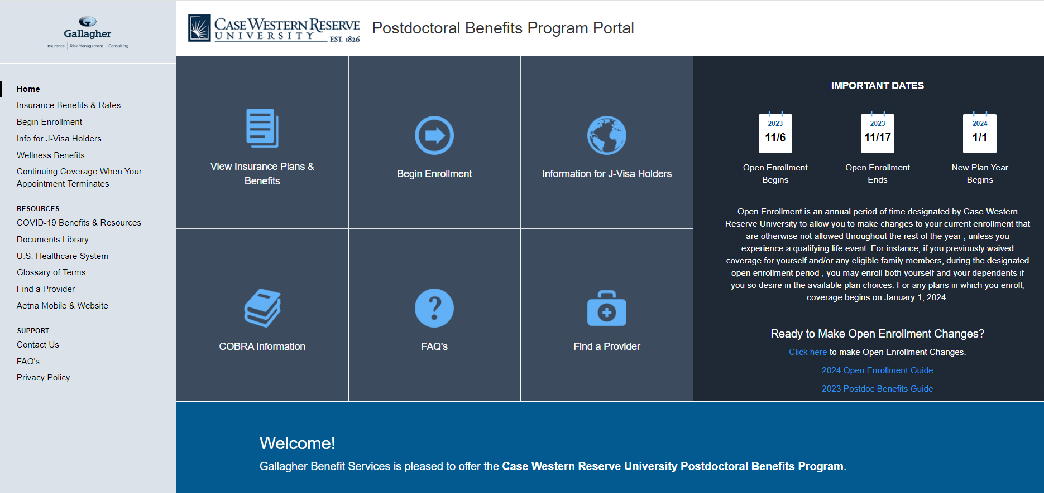
The Enrollment Process
To make your plan elections, visit the Gallagher web site at https://clients.garnett-powers.com/pd/case/ and click on Begin Enrollment.
Fill out the form. Once complete, you will click Submit and Create Printable Enrollment Form which will send your form to our secure database and also allow you to print a copy of your enrollment form for your records.

Slide 34
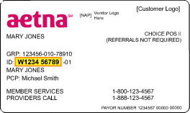
The Enrollment Process
An e-mail will be sent within 24 hours confirming receipt of your enrollment.
ID cards will be mailed to your home directly from the Insurance Carriers (Aetna and EyeMed). You will not receive an ID card from MetLife Dental, however you will receive a confirmation email with instructions on how to print one.

Slide 35
Family Member Eligibility
Family member eligibility requirements are the same as the family member eligibility requirements for the Case Western Reserve University faculty/staff plans.
The Major Family Member Categories Are:
  Spouse
  Dependent children to age 26 regardless of student status
  Stepchildren may be included if they live with the Postdoc and are supported at more than 50% and claimed as a tax dependent
  Same-sex domestic partner
The required Declaration of Domestic Partnership form, found on the home page of the GBS benefit program website under Important Information, must be completed, signed and notarized then emailed to UniversityServices.GBS.casepbp@ajg.com

Slide 36

Proud Sponsor of the NPA
We are a proud Distinguished Partner of the National Postdoctoral Association (NPA)!
We have supported the NPA for many years, providing support as they bring their valuable resources to postdocs throughout the world, such as:
Working to establish Postdoc Offices and Postdoc Associations
Updating and developing postdoc resources
Advocate on the institutional, regional, and national levels to enhance the
postdoctoral experience
Improve benefits for all postdocs
Increase support of quality mentoring for postdocs
Provide/facilitate professional and career development opportunities for postdocs
Encourage and facilitate diversity within the postdoctoral community
36
Notes:
KEEP THIS SLIDE?

Slide 37

Information Sources
For general inquiries and customer service regarding enrollment, benefit questions and ID cards, please contact:
Diana Fox| Your Dedicated GBS Representative
Tel: 1 (949) 317-5917 | Email: UniversityServices.GBS.casepbp@ajg.com
clients.garnett-powers.com/pd/case

